Slide 1
Impedance and Admittance
Linear Circuit Analysis II
EECE 202

Slide 2
Announcement
GCA1 during Week 5 Second Lecture

Slide 3
Recap
Solving equation differential and integrals using LT
New Material
Impedances
Admittances

Slide 4
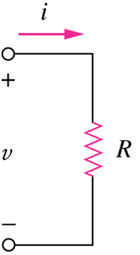
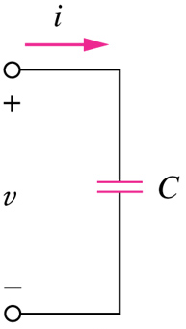
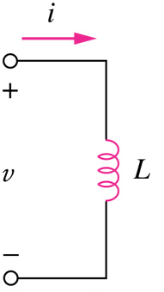
Passive Elements
Resistor
Inductor
Capacitor

Slide 5
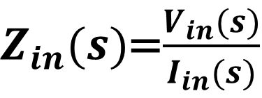

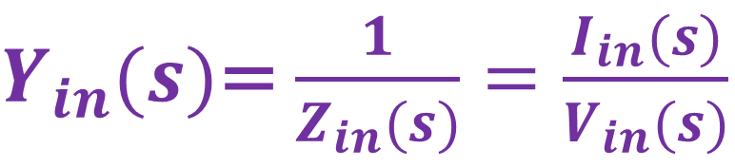
What is an Impedance??
Impedance is a generalized Resistance that is frequency dependent
Z
Impedance, denoted Z_{in}(s), in the s-­‐‑world,
in the total absence of initial conditions, is:
$Z_{in}(s)$=$\frac{V_{in}(s)}{I_{in}(s)}$
Ω
V_{in}(s) = Z_{in}(s) × I_{in}(s)
$Y_{in}(s)$=$\frac{1}{Z_{in}(s)}=\frac{I_{in}(s)}{V_{in}(s)}$
$$Ω^{−1}$$

Slide 6


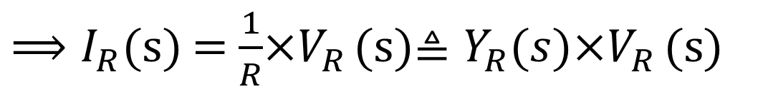
Resistance Impedance/Admittance
In the total absence of initial conditions
$${In time domain, v}_{R}=Ri_{R}$$
$${In "s" domain, V}_{R}(s)=RI_{R}(s)≜Z_{R}\left(s\right)I_{R}\left(s\right)$$
${⟹I}_{R}$(s) = $\frac{1}{R}$×$V_{R}$ (s)$≜Y_{R}(s)\text{×}V_{R} \text{(}\text{s}\text{)}$
$Result:$ $Z_{R}\left(s\right)=R$ and $Y_{L}\left(s\right)=\frac{1}{R}$
Note: At s = 0, the impedance of the inductor is zero meaning the inductor looks like a short circuit

Slide 7
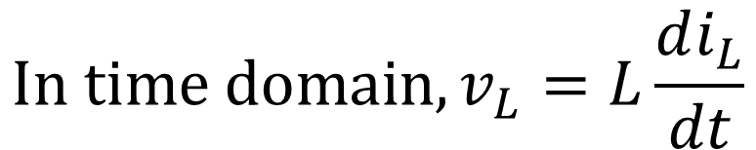

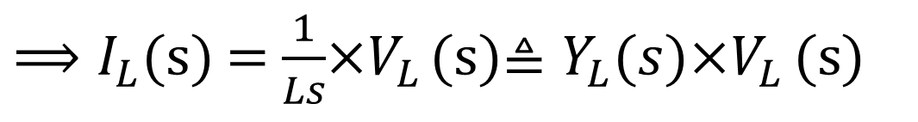
Inductance Impedance/Admittance
In the total absence of initial conditions
$${In time domain, v}_{L}=L\frac{di_{L}}{dt}$$
$${In "s" domain, V}_{L}(s)=LsI_{L}(s)≜Z_{L}\left(s\right)I_{L}\left(s\right)$$
${⟹I}_{L}$(s) = $\frac{1}{Ls}$×$V_{L}$ (s)$≜Y_{L}(s)\text{×}V_{L} \text{(}\text{s}\text{)}$
$Result:$ $Z_{L}\left(s\right)=Ls$ and $Y_{L}\left(s\right)=\frac{1}{Ls}$
Note: At s = 0, the impedance of the inductor is zero meaning the inductor looks like a short circuit

Slide 8
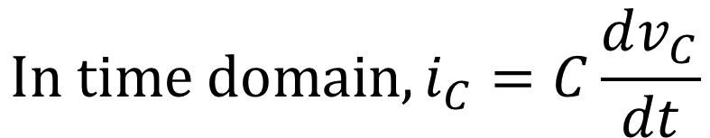

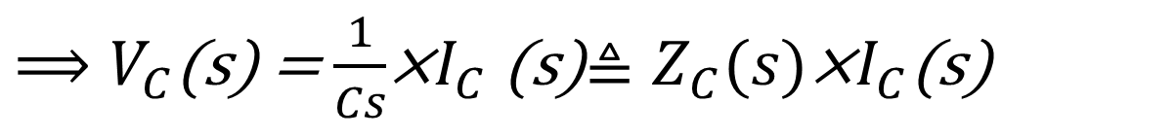
Capacitance Impedance/Admittance
In the total absence of initial conditions
$${In time domain, i}_{C}=C\frac{dv_{C}}{dt}$$
$${In "s" domain,I}_{C}(s)=CsV_{C}(s)≜Y_{C}(s)V_{C}(s)$$
${⟹V}_{C}$(s) = $\frac{1}{Cs}$×$I_{C}$ (s)$≜Z_{C}(s)\text{×}I_{C}\text{(}\text{s}\text{)}$
$Result:$ $Z_{C}\left(s\right)=\frac{1}{Cs}$ and $Y_{L}\left(s\right)=Cs$
Note: At s = 0, the impedance of the capacitor is infinite meaning the capacitor looks like an open circuit

Slide 9
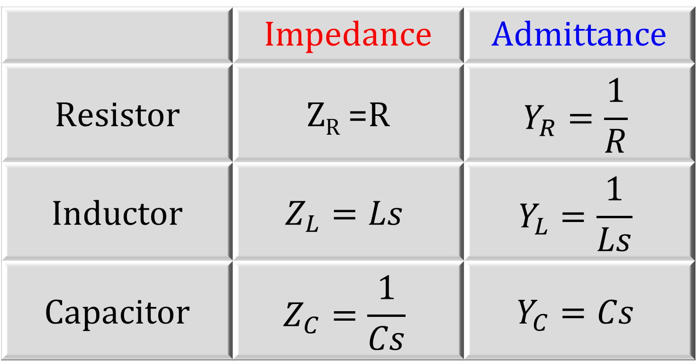
 | Impedance | Admittance
Resistor | Z_{R} =R | $$Y_{R}=\frac{1}{R}$$
Inductor | $$Z_{L}=Ls$$ | $$Y_{L}=\frac{1}{Ls}$$
Capacitor | $$Z_{C}=\frac{1}{Cs}$$ | $$Y_{C}=Cs$$

Slide 10
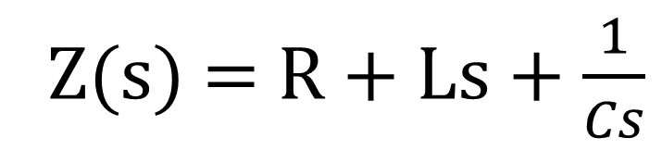
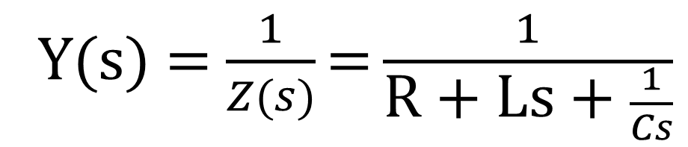
Series Circuit
Manipulation RULES
In the total absence of the initial conditions, find the equivalent impedance and admittance for the shown series connection :
R
L
V (s)
Z(s) = R + Ls + $\frac{1}{Cs}$
+
I(s)
C
Ω
-
Y(s) = $\frac{1}{Z(s)}\text{=}\frac{1}{\text{R}\text{ + }\text{Ls}\text{ + }\frac{1}{Cs}}$
Ω⁻¹

Slide 11
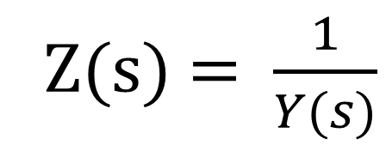
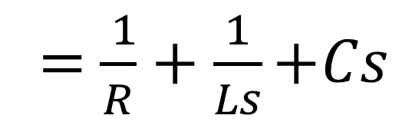
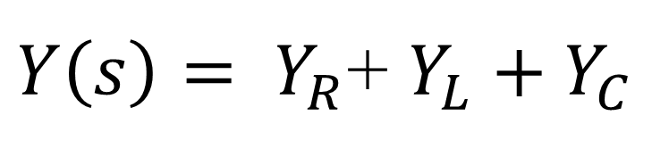
Parallel Circuit
Manipulation RULES
In the total absence of the initial conditions, find the equivalent impedance and admittance for the shown parallel connection :
$Y\left(s\right)= Y_{R}$+ $Y_{L}+Y_{C}$
+
V (s)
R
L
C
-
= $\frac{ 1}{R}+\frac{1}{Ls}$ $+Cs$
Ω⁻¹
R
Z(s) = $\frac{1}{Y(s)}$
+
V (s)
C
-

Slide 12
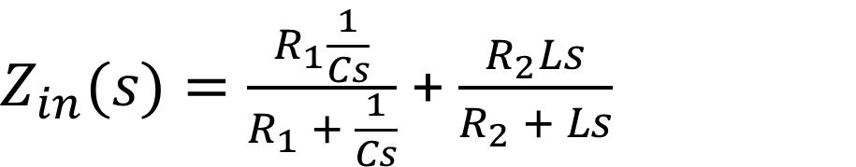
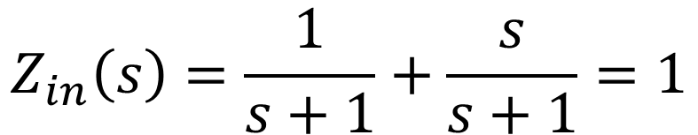
Example 1
Assume zero initial conditions, find the input impedance seen by the source. Assume all parameter values are 1.
$Z_{in}(s)=\frac{R_{1}\frac{1}{Cs}}{R_{1} + \frac{1}{Cs}}$ + $\frac{R_{2}Ls}{R_{2} + Ls}$
$$Z_{in}\left(s\right)=\frac{1}{s+1}+\frac{s}{s+1}=1$$

Slide 13
Example 13.14 (p. 613)
For the shown circuit, Compute the following:
1-Draw the circuit in the S-domain.
2- Find Z(s).
3-Find V₀(s) in terms of V(s).
4-Given that v(t) = u(t), find v₀(t).
0.1 F
I (s)
+
+
Assume zero initial conditions
V (s)
10Ω
1H
V₀ (s)
-
2Ω
Z_{R1} = R₁ = 10 Ω
Z_{R2} = R₂ = 2 Ω
Z_{L} = Ls = 1s Ω
Z_{C} = 1/(sC) = 1/(0.1s) = 10/s Ω
-
Z (s)

Slide 14
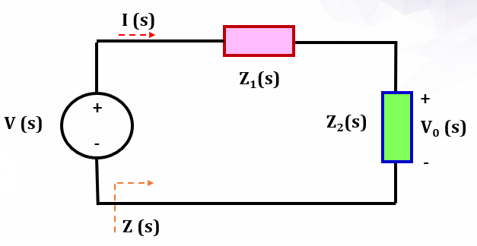
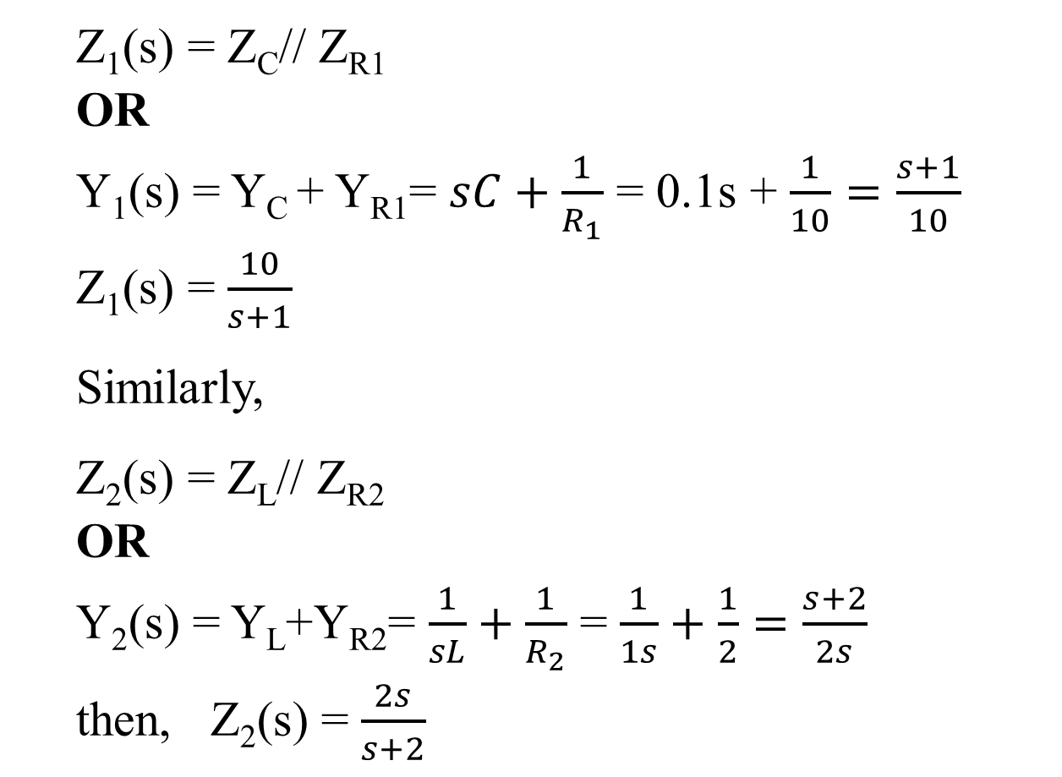
Example 13.14 (contin…)
Z₁(s) = Z_{C}// Z_{R1}
OR
Y₁(s) = Y_{C} + Y_{R1}= $sC+\frac{1}{R_{1}}$ = 0.1s + $\frac{1}{10}=\frac{s+1}{10}$
Z₁(s) = $\frac{10}{s+1}$
Similarly,
Z₂(s) = Z_{L}// Z_{R2}
OR
Y₂(s) = Y_{L}+Y_{R2}= $\frac{1}{sL}+\frac{1}{R_{2}}$ = $\frac{1}{1s}+\frac{1}{2}=\frac{s+2}{2s}$
then, Z₂(s) = $\frac{2s}{s+2}$
Ω
Ω

Slide 15
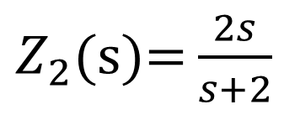
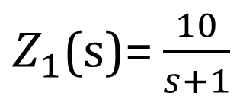
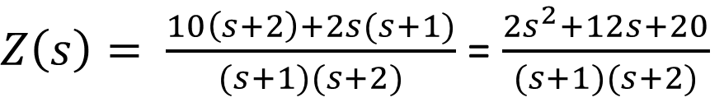
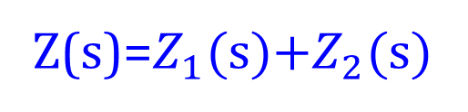
Example 13.14 (contin…)
I (s)
$Z_{1}$(s)= $\frac{10}{s+1}$
Ω
Z₁(s)
+
+
V (s)
Z₂(s)
V₀ (s)
-
-
$Z_{2}$(s)= $\frac{2s}{s+2}$
Ω
Z (s)
Z(s)=$Z_{1}$(s)+$Z_{2}$(s)
$Z\left(s\right)= \frac{10\left(s+2\right)+2s(s+1)}{(s+1)(s+2)}$ = $\frac{2s^{2}+12s+20}{(s+1)(s+2)}$
Ω

Slide 16
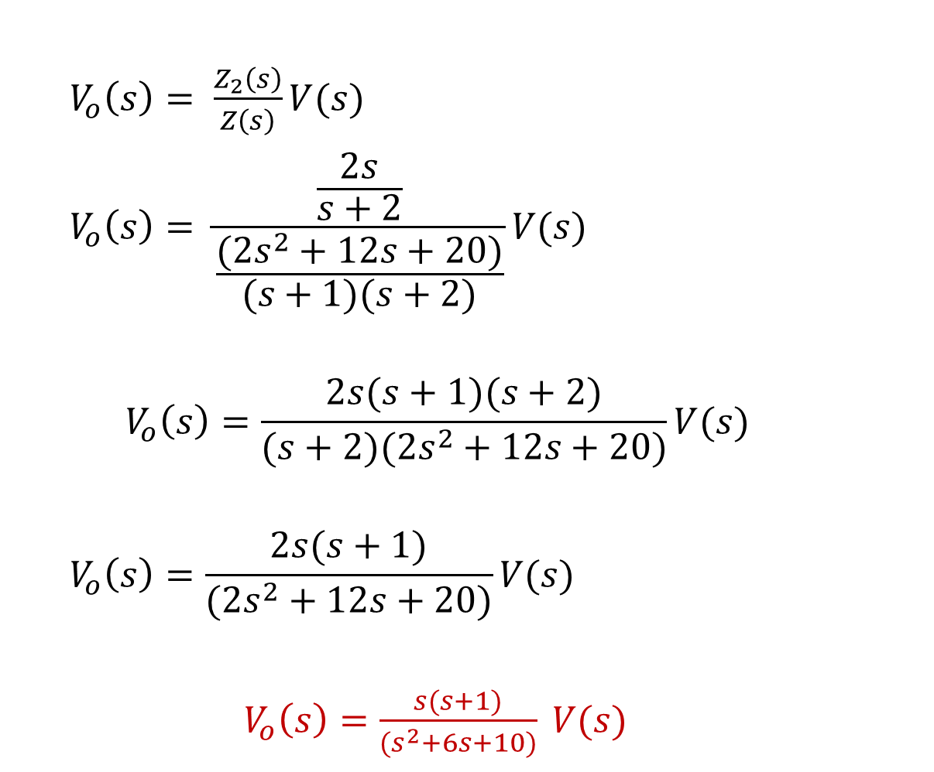
Example 13.14 (contin…)
$V_{o}\left(s\right)= \frac{Z_{2}\left(s\right)}{Z\left(s\right)}V(s)$
$$V_{o}\left(s\right)= \frac{\frac{2s}{s+2}}{\frac{(2s^{2}+12s+20)}{(s+1)(s+2)}}V(s)$$
$$V_{o}\left(s\right)=\frac{2s(s+1)(s+2)}{(s+2)(2s^{2}+12s+20)}V(s)$$
$$V_{o}\left(s\right)=\frac{2s(s+1)}{(2s^{2}+12s+20)}V(s)$$
$V_{o}\left(s\right)=\frac{s(s+1)}{(s^{2}+6s+10)} V(s)$

Slide 17
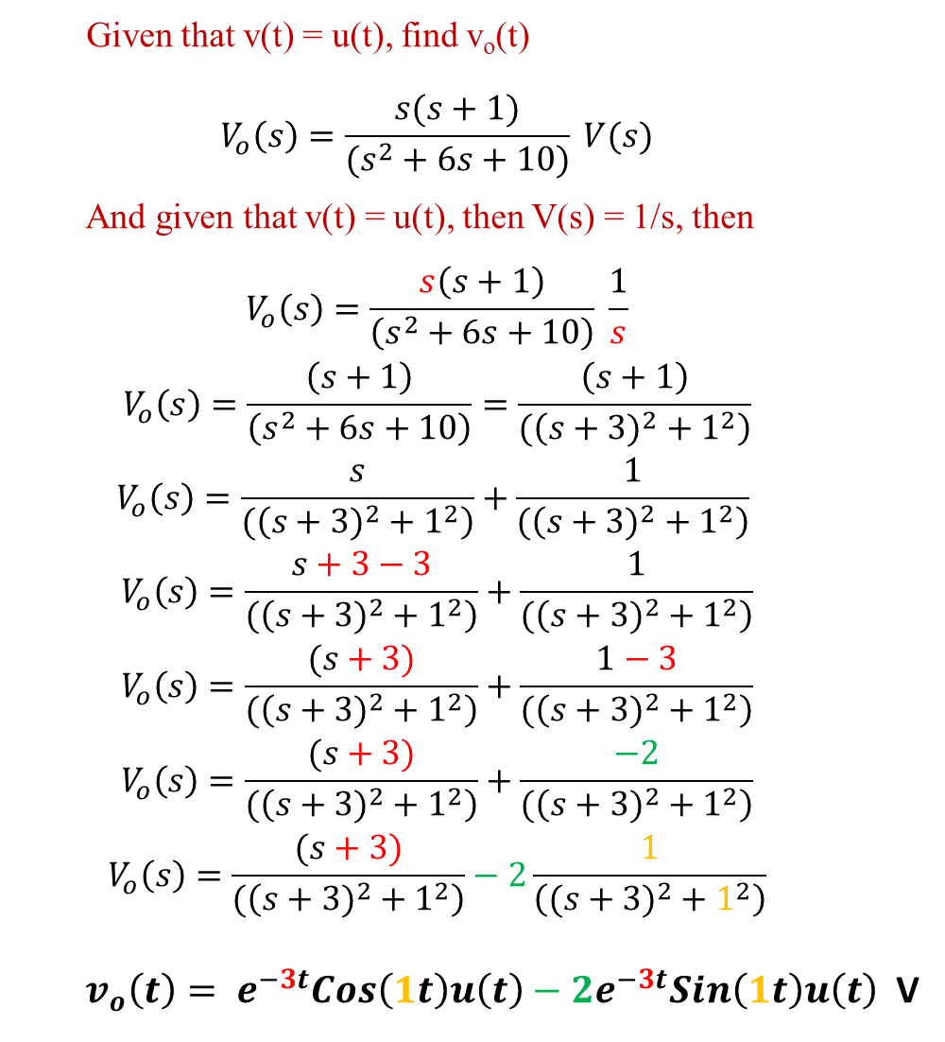
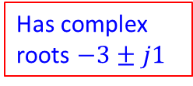
Given that v(t) = u(t), find v_{o}(t)
$$V_{o}\left(s\right)=\frac{s(s+1)}{(s^{2}+6s+10)} V(s)$$
And given that v(t) = u(t), then V(s) = 1/s, then
$$V_{o}\left(s\right)=\frac{s\left(s+1\right)}{\left(s^{2}+6s+10\right)} \frac{1}{s}$$
$$V_{o}\left(s\right)=\frac{\left(s+1\right)}{\left(s^{2}+6s+10\right)}=\frac{\left(s+1\right)}{(\left({s+3)}^{2}+1^{2}\right)}$$
$$V_{o}\left(s\right)=\frac{s}{(\left({s+3)}^{2}+1^{2}\right)}+\frac{1}{(\left({s+3)}^{2}+1^{2}\right)}$$
$$V_{o}\left(s\right)=\frac{s+3−3}{(\left({s+3)}^{2}+1^{2}\right)}+\frac{1}{(\left({s+3)}^{2}+1^{2}\right)}$$
$$V_{o}\left(s\right)=\frac{(s+3)}{(\left({s+3)}^{2}+1^{2}\right)}+\frac{1−3}{(\left({s+3)}^{2}+1^{2}\right)}$$
$$V_{o}\left(s\right)=\frac{(s+3)}{(\left({s+3)}^{2}+1^{2}\right)}+\frac{−2}{(\left({s+3)}^{2}+1^{2}\right)}$$
$$V_{o}\left(s\right)=\frac{(s+3)}{(\left({s+3)}^{2}+1^{2}\right)}−2\frac{1}{\left(({s+3)}^{2}+1^{2}\right)}$$
$v_{o}\left(t\right)= e^{−3t}Cos\left(1t\right)u\left(t\right)−2e^{−3t}Sin\left(1t\right)u\left(t\right)$ V
Has complex roots $−3±j1$
Repeat example 13.14 for R₂=10 Ω and C= 0.01 F

Slide 18
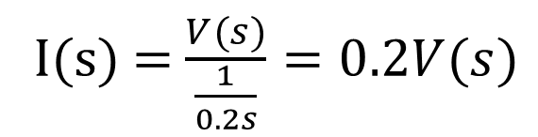
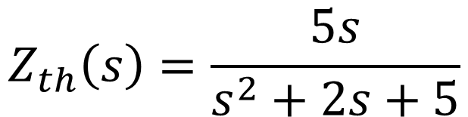
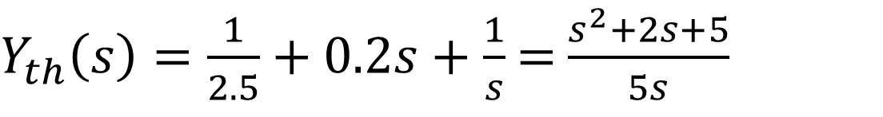
Example 1
Assume zero initial conditions, Use source transformation to determine Z_{th} (s) for the indicated terminals
0.2F
By source transformation :
+
I(s) = $\frac{V(s)}{\frac{1}{0.2s}}=0.2V(s)$
V (s)
1H
-
2.5Ω
Turn the current source off :
$$Y_{th}\left(s\right)=Y_{R}(s)+Y_{C}(s)+Y_{L}(s)$$
$Y_{th}\left(s\right)=\frac{1}{2.5}+0.2s+\frac{1}{s}$= $\frac{s^{2}+2s+5}{5s}$
I(s)
1H
0.2F
2.5Ω
$$Z_{th}\left(s\right)=\frac{5s}{s^{2}+2s+5}$$
Notes:
This is an example from page 617, exercise 3. Do this example.

Slide 19
Use AI and answer following questions
What is the difference between impedance and admittance in a circuit?
How does frequency affect the impedance of an inductor and a capacitor?
Why does the impedance of an inductor behave like a short circuit at low frequencies?
How does admittance simplify the analysis of parallel circuits?
Solve Activity

Slide 20
Summary
Inductance Impedance
Capacitance Impedance
Series circuit manipulation rules
Series circuit manipulation rules
Suggested Additional Problems for Ch. 13:
Example 13.1 (p. 609), 13.2 (p. 611), 13.3 (p. 612),
Exercise (p. 606), (p. 607)???

